Slide 1
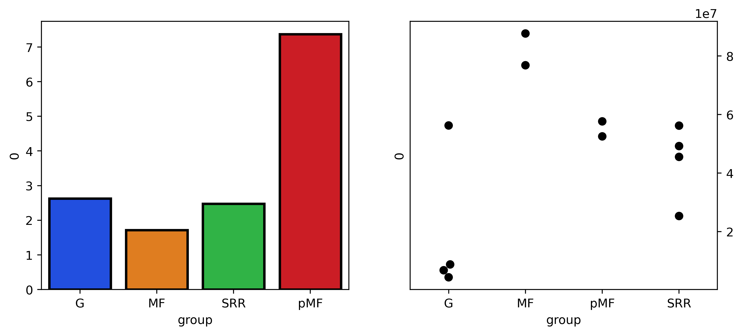
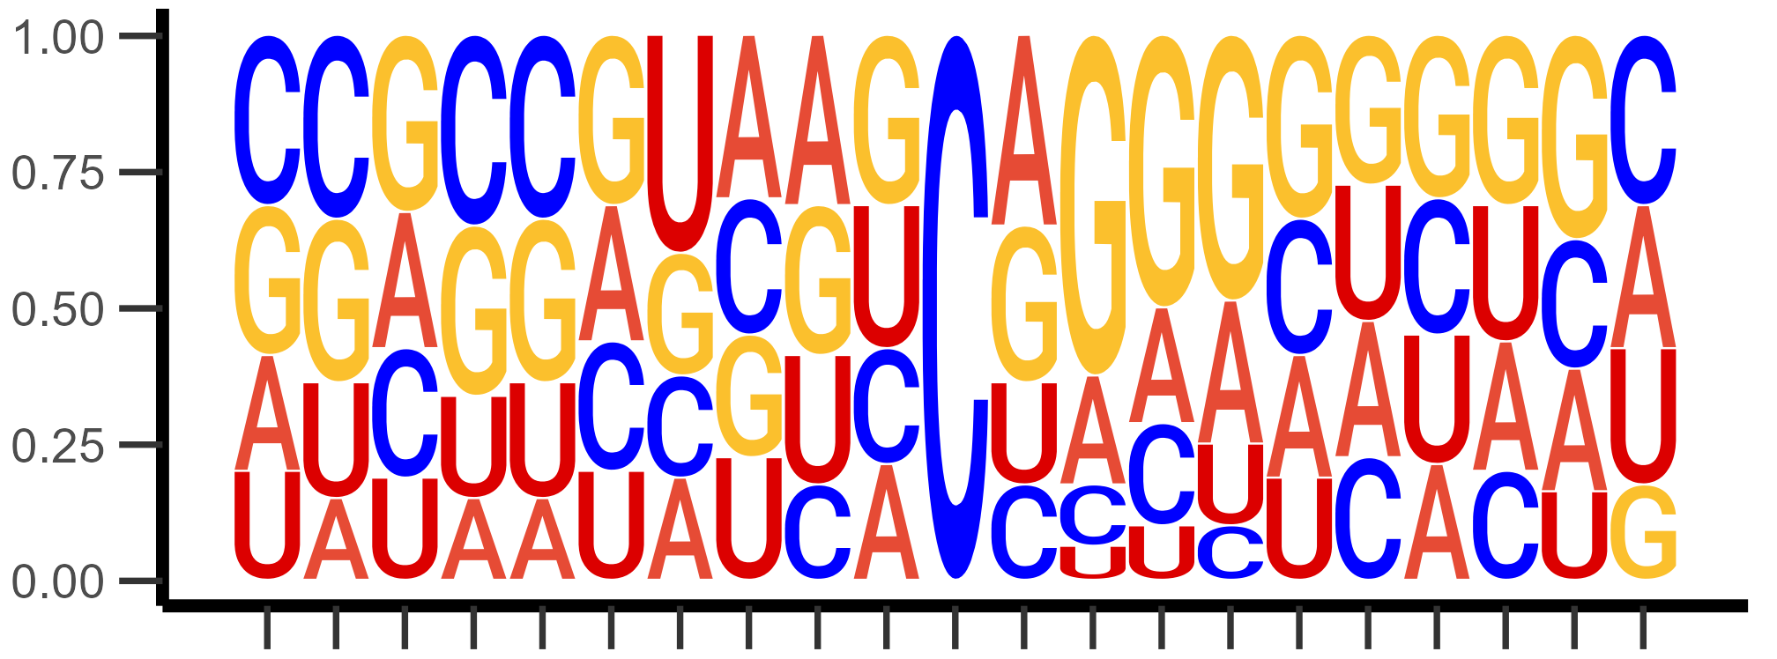
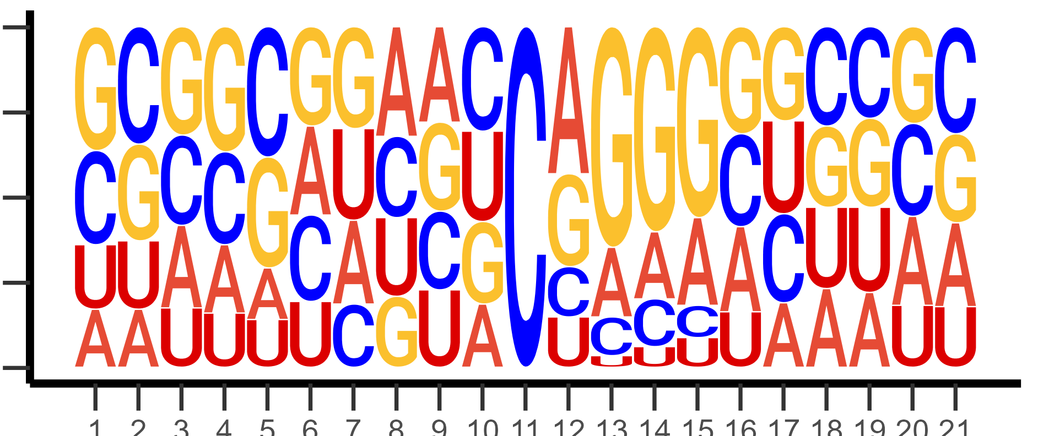
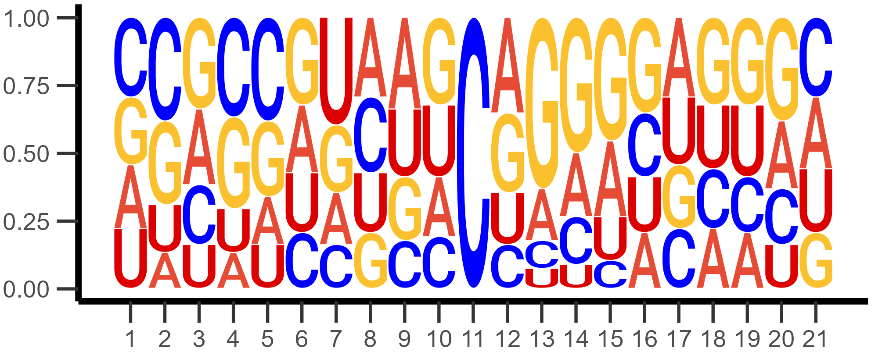
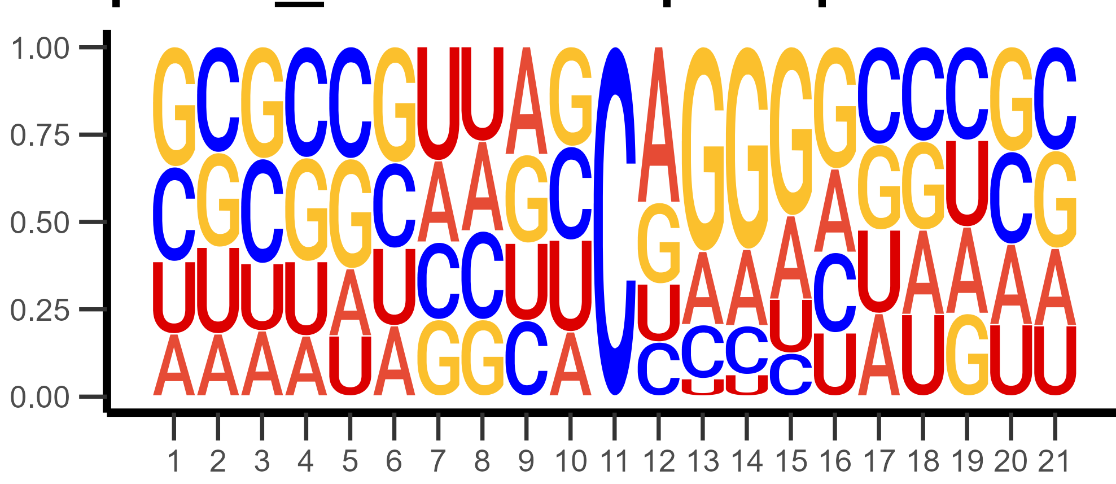
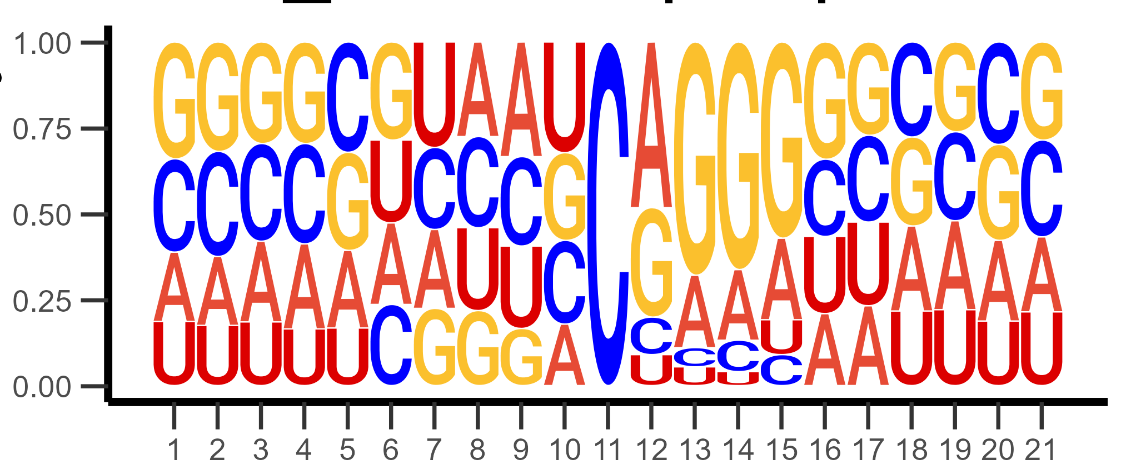
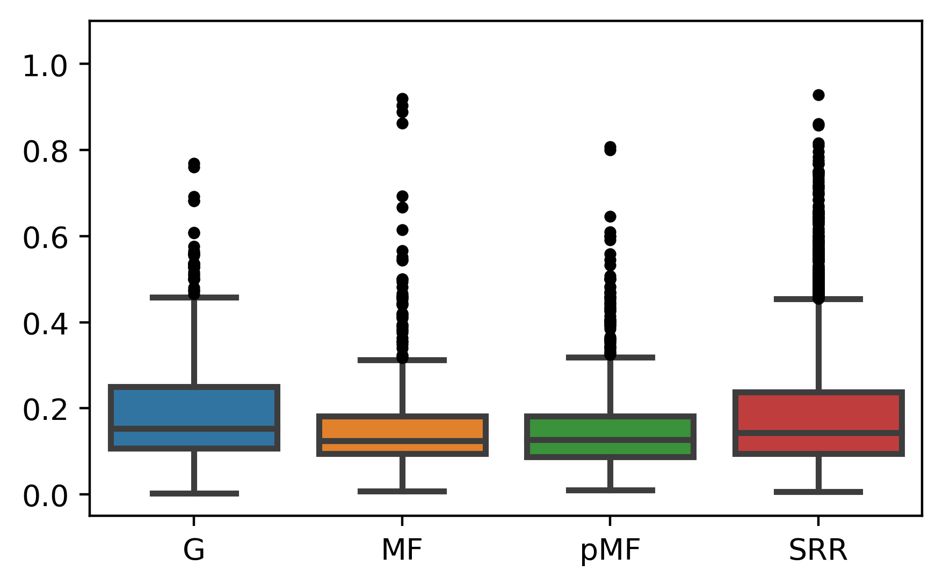
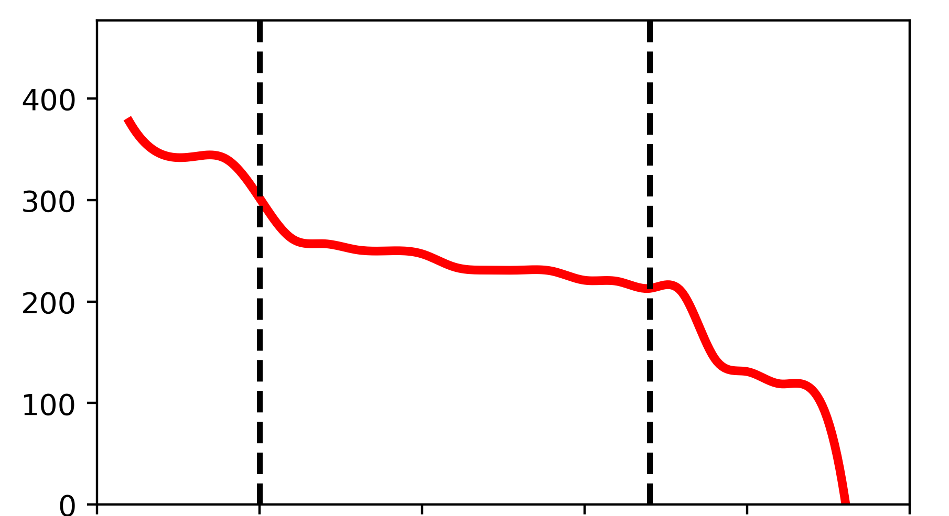
A
Mitochondrial union
sites
Total RNA sites
133
20
154
Union of sites/
Total mapped read pairs
Mapped reads
per replicate (x10⁷)
59
45
31
208
MT
RNA
Total
RNA
Polysome
RNA
Huang
Polysome RNA sites
C
N=120
Total RNA
N=264
Mitochondrial RNA
Probability
N=343
Polysomal RNA
Huang
N=1,275
Position
D
E
Methylation level
Sites
MT
RNA
Total
RNA
Polysome
RNA
Huang
5’UTR
CDS
3’UTR
Notes:
(A) Ratio of final m⁵C sites per 10⁷ mapped reads of bisulfite-converted libraries displayed as bars on the left-hand axis. Mapped reads of individual libraries are displayed as points on the right-hand axis. (B) Overlap of m⁵C sites among NSC libraries. (C) Sequence logo of m⁵C sites in each condition. (D) Methylation level of m⁵C sites. (E) Site count across transcript length binned according to individual transcript length. Dashed lines are drawn at the approximate beginning and end of the transcript exon.

Slide 2
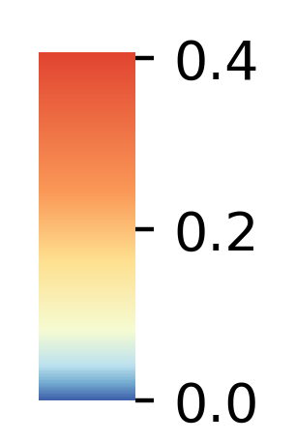
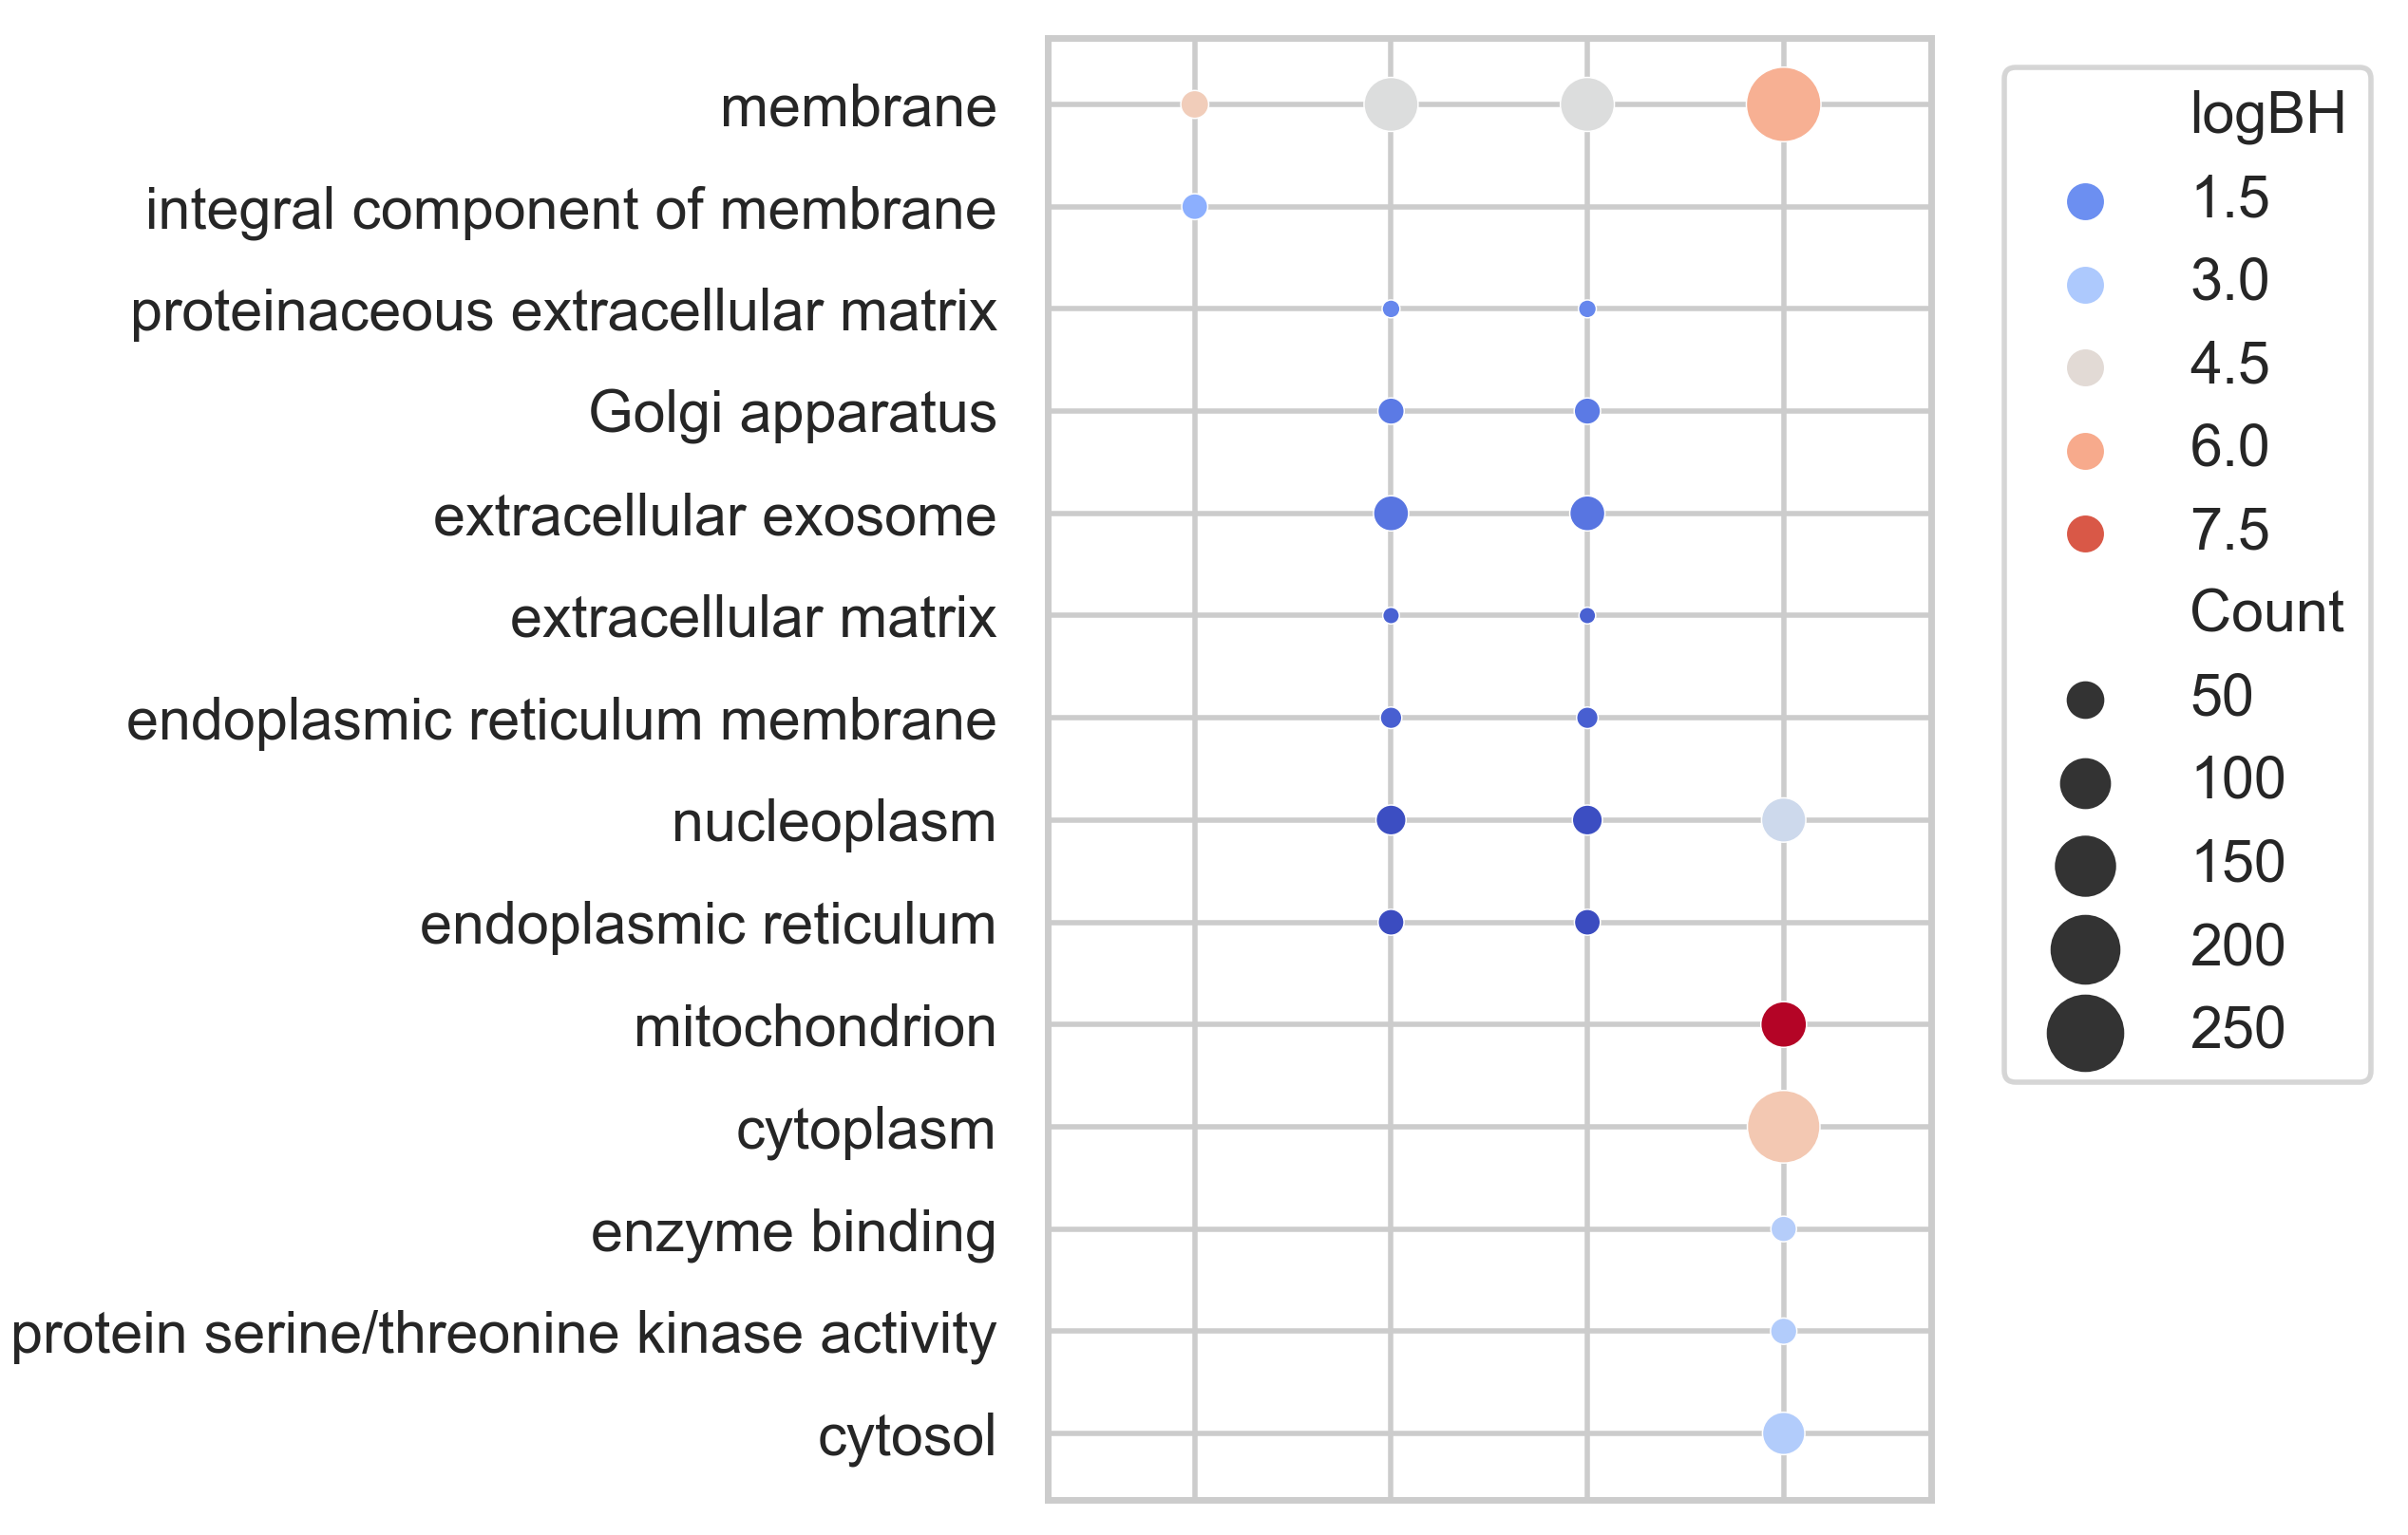
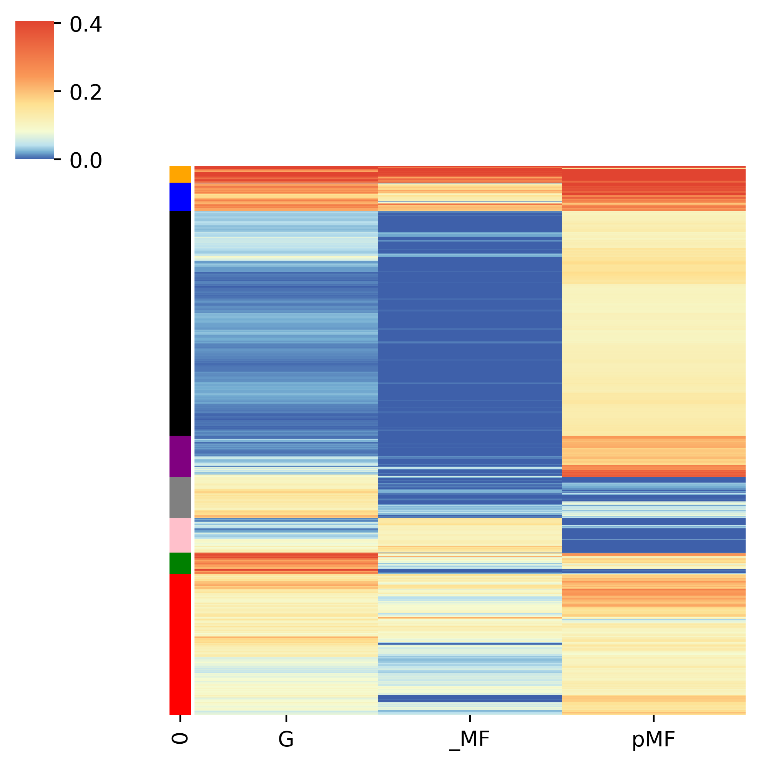
G
F
N = 635
MT libraries
Huang
MT
RNA
Total
RNA
Polysome
RNA
Total RNA
Polysome RNA
Notes:
(F) Heatmap of m⁵C sites across all libraries used in this study. Sites must have passed all filters in at least one condition. Methylated sites with coverage in all groups were plotted and clustered according to methylation level. (G) Gene ontology analysis of methylated sites in each condition. Biological Process (BP), Cellular Component (CC), and Molecular Function (MF) IDs are included. p-values are adjusted according to the Bonferroni method. (H) Genes enriched by methylation level in each cellular compartment of mouse NSCs.

